Slide 1
NLTK Essentials
Text Wrangling and Cleansing
Presentation presenter: Plessias alexandros
Notes:
Σύγκρουση (Wrangling) με το κείμενο και καθαρισμός

Slide 2
Presentation’s content
What is text wrangling?
Text cleansing
Sentence splitter
Tokenization
Stemming
Lemmatization
Stop word removal
Rare word removal
Spell correction

Slide 3
What is text wrangling?

Slide 4
What is text wrangling?
It's really hard to define the term text/data wrangling. I will define it as all the pre-processing and all the heavy lifting you do before you have a machine readable and formatted text from raw data.
The process involves data munging, text cleansing, specific preprocessing, tokenization, stemming or lemmatization and stop word removal.
Notes:
the heavy lifting = η βαριά ανύψωση Data Munging = cleaning up a messy data set.

Slide 5
Parsing text/data (1/2)
I have listed most common data sources in the first stack of the diagram. In most cases, the data will be one of these data formats. In the next step, I have listed the most commonly used Python wrappers around those data formats.
So before you write your own parser to parse these different document formats, please have a look at the second row for available parsers in Python. Once you reach a raw string, all the pre-processing steps can be applied as a pipeline, or you might choose to ignore some of them.
Notes:
wrapper = a python module that interface between python and a 3rd party library offering a non python interface.

Slide 6
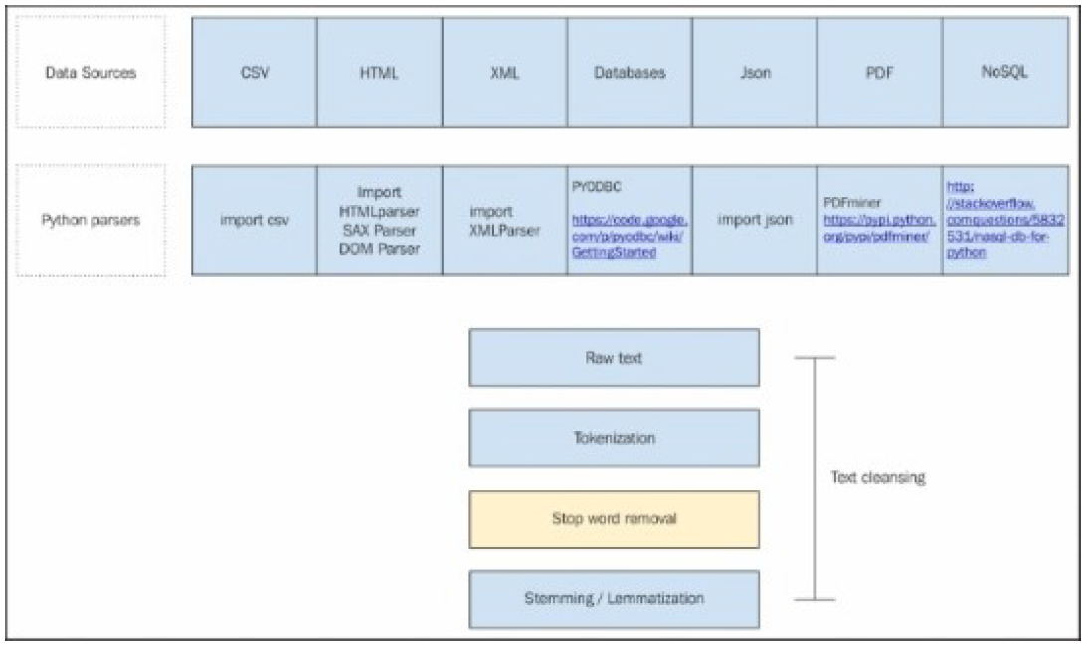
Parsing text/data (2/2)

Slide 7
Text cleansing

Slide 8
Text cleansing
Once we have parsed the text from a variety of data sources, the challenge is to make sense of this raw data. Text cleansing is used for most of the cleaning to be done on text, depending on the data source, parsing performance, external noise and so on.
For example cleaning the html using html_clean, can be labeled as text cleansing.
In another case, where we are parsing a PDF, there could be unwanted noisy characters, non ASCII characters to be removed, and so on. Before going on to next steps we want to remove these to get a clean text to process further.
With a data source like xml, we might only be interested in some specific elements of the tree, with databases we may have to manipulate splitters, and sometimes we are only interested in specific columns.
In summary, any process that is done with the aim to make the text cleaner and to remove all the noise surrounding the text can be termed as text cleansing.
There are no clear boundaries between the terms data munging, text cleansing, and data wrangling they can be used interchangeably in a similar context.
Notes:
data munging = cleaning up a messy data set.
they can be used interchangeably in a similar context = μπορούν να χρησιμοποιηθούν εναλλακτικά σε ένα παρόμοιο περιεχόμενο.

Slide 9
Sentence splitter

Slide 10
Sentence splitter (1/2)
Some of the NLP applications require splitting a large raw text into sentences to get more meaningful information out. Intuitively, a sentence is an acceptable unit of conversation. When it comes to computers, it is a harder task than it looks. A typical sentence splitter can be something as simple as splitting the string on (.), to something as complex as a predictive classifier to identify sentence boundaries.
Notes:
Intuitively, a sentence is an acceptable unit of conversation. = Eνστικτωδώς, η πρόταση είναι μια αποδεκτή μονάδα συνομιλίας.
A typical sentence … = Ένας τυπικός διαιρέτης πρότασης μπορεί να είναι κάτι τόσο απλό όσο το χώρισμα της συμβολοσειράς σε (.),
σε κάτι τόσο περίπλοκο όσο ένας προγνωστικός ταξινομητής για τον προσδιορισμό των ορίων της πρότασης.

Slide 11
Sentence splitter (2/2)
The preceding sentence splitter is available in 17 languages*. You just need to specify the respective object. This is good enough to deal with a variety of the text corpus, and there is a lesser chance that you will have to build your own.
If your application requires a custom sentence splitter, there are ways that we can train a sentence splitter of our own using:
import nltk.tokenize.punkt nltk.tokenize.punkt.PunktSentenceTokenizer()
* Czech, Danish, Dutch, English, Estonian, Finnish, French, German, Greek, Italian, Norwegian, Polish, Portuguese, Slovene, Spanish, Swedish & Turkish
Notes:
Ο διαχωριστής της προηγούμενης πρότασης είναι διαθέσιμος σε 17 γλώσσες *. Απλά πρέπει να καθορίσετε το αντίστοιχο αντικείμενο.
Αυτό είναι αρκετά καλό για να αντιμετωπίσετε μια ποικιλία από text corpus, και υπάρχει μικρότερη πιθανότητα να δημιουργήσουμε τη δική μας
Αν η εφαρμογή απαιτεί έναν προσαρμοσμένο διαιρέτη προτασεων, υπάρχουν τρόποι με τους οποίους μπορούμε να εκπαιδεύσουμε έναν διαιρέτη πρότασης δικής μας χρήσης:

Slide 12
Tokenization

Slide 13
Tokenization
A word (Token) is the minimal unit that a machine can understand and process. So any text string cannot be further processed without going through tokenization. Tokenization is the process of splitting the raw string into meaningful tokens. The complexity of tokenization varies according to the need of the NLP application, and the complexity of the language itself. For example, in English it can be as simple as choosing only words and numbers through a regular expression. But for Chinese and Japanese, it will be a very complex task.
There are two most commonly used tokenizers:
The first is word_tokenize, which is the default one, and will work in most cases.
The other is regex_tokenize, which is more of a customized tokenizer for the specific needs of the user.
Most of the other tokenizers can be derived from regex tokenizers. You can also build a very specific tokenizer using a different pattern.
Notes:
Token = λεκτική μονάδα

Slide 14
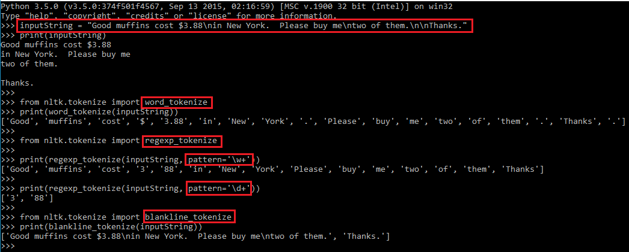
Tokenization examples
Notes:
Token = λεκτική μονάδα

Slide 15
Stemming
Notes:
Stemming = αποκοπή καταλήξεων (γλωσσολογία)

Slide 16
Stemming
Stemming, in literal terms, is the process of cutting down the branches of a tree to its stem. So effectively, with the use of some basic rules, any token can be cut down to its stem.
Stemming is more of a crude rule-based process by which we want to club together different variations of the token.
For example, the word eat will have variations like eating, eaten, eats, and so on.
In some applications, as it does not make sense to differentiate between eat and eaten, we typically use stemming to club both grammatical variances to the root of the word.
While stemming is used most of the time for its simplicity, there are cases of complex language or complex NLP tasks where it's necessary to use lemmatization instead.
Notes:
Το Stemming είναι περισσότερο μια πρόχειρη διαδικασία βασισμένη σε κανόνες, με την οποία θέλουμε να συνενώσουμε διαφορετικές παραλλαγές του συμβόλου (token).
variations = παραλλαγές
Σε μερικές εφαρμογές, δεν έχει νόημα να διαφοροποιείται το τρώω και το τρώγονται, τυπικά χρησιμοποιούμε stemming μια να ομαδοποιήσουμε τις γραμματικές διαφορές στη ρίζα της λέξης.

Slide 17
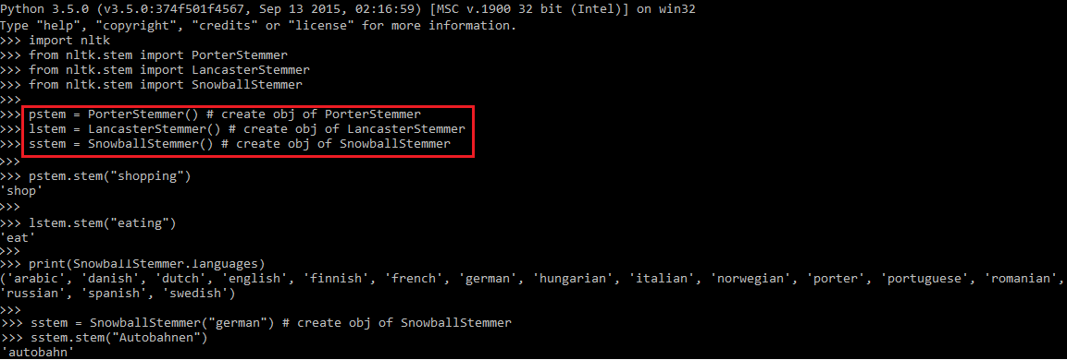
Stemming examples (1/2)
Notes:
Autobahnen = αυτοκινητόδρομους Porter : Βασικός αλγόριθμος stemming. Lancaster : Είναι σημαντικά πιο επιθετικός από τον Porter. Snowball : Χρησιμοποιείτε για αρκετές γλώσσες και υλοποιεί στα Αγγλικά το Porter2

Slide 18
Stemming examples (2/2)
We are creating different stemmer objects, and applying a stem() method on the string. As you can see, there is not much of a difference when you look at a simple example, however there are many stemming algorithms around, and the precision and performance of them differ.
A basic rule-based stemmer, like removing –s/es or -ing or -ed can give you a precision of more than 70 percent.
Porter stemmer uses more rules and can achieve very good accuracies and if you are working with English, it's good enough.
There is a family of Snowball stemmers that can be used for Dutch, English (Porter 2), French, German, Italian, Portuguese, Romanian, Russian, and so on.
But most users can live with Porter and Snowball stemmer for a large number of use cases.
In modern NLP applications, sometimes people even ignore stemming as a pre-processing step, so it typically depends on your domain and application. I would also like to tell you the fact that if you want to use some NLP taggers, like Part of Speech tagger (POS), NER or dependency parser, you should avoid stemming, because stemming will modify the token and this can result in a different result.
Notes:
Part of Speech tagger (POS) = Μέρος του λογου Named Entity Recognition (NER) = Αναγνώριση ονομαστικής οντότητας dependency parser = αναλυτή εξάρτησης

Slide 19
Lemmatization
Notes:
Lemmatization = Λεξικογραφικά συνιστά τον πιο συνηθισμένο τύπο μιας λέξης που σ' αυτήν ανήκουν ή απ' αυτήν παράγονται νέες λέξεις

Slide 20
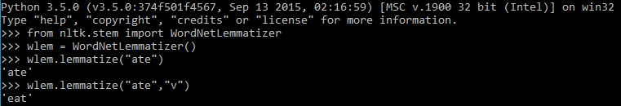
Lemmatization
Lemmatization is a more methodical way of converting all the grammatical/inflected forms of the root of the word. Lemmatization uses context and part of speech to determine the inflected form of the word and applies different normalization rules for each part of speech to get the root word (lemma):
Here, WordNetLemmatizer is using wordnet*, which takes a word and searches wordnet, a semantic dictionary. It also uses a morph analysis to cut to the root and search for the specific lemma. Hence, in our example it is possible to get eat for the given variation ate, which was never possible with stemming.
* http://wordnet.princeton.edu/wordnet/
Notes:
H Λημματοποίηση είναι ένας πιο μεθοδικός τρόπος μετατροπής όλων των γραμματικών / κλιτών μορφών της ρίζας μιας λέξης.
Η Λημματοποίηση χρησιμοποιεί το περιεχόμενο και τα μέρει του λόγου για τον προσδιορισμό της κλίσης (πχ του ρήματος) της λέξης και εφαρμόζει
διαφορετικούς κανόνες κανονικοποίησης για κάθε μέρος του λόγου για να πάρει τη λέξη ρίζα (λήμμα): Χρησιμοποιεί επίσης μορφολογική ανάλυση για να κόψει τη ρίζα της λέξης και να αναζητήσει το συγκεκριμένο λείμμα (ανάμεσα στις παραλλαγή της λέξης).

Slide 21
Stop word removal

Slide 22
Stop word removal
Stop word removal is one of the most commonly used preprocessing steps across different NLP applications. The idea is simply removing the words that occur commonly across all the documents in the corpus.
Typically, articles and pronouns are generally classified as stop words. These words have no significance in some of the NLP tasks like information retrieval and classification, which means these words are not very discriminative.
On the contrary, in some NLP applications stop word removal will have very little impact. Most of the time, the stop word list for the given language is a well hand-curated list of words that occur most commonly across corpuses.
While the stop word lists for most languages are available online, these are also ways to automatically generate the stop word list for the given corpus. A very simple way to build a stop word list is based on word's document frequency (Number of documents the word presents), where the words present across the corpus can be treated as stop words.
I would recommend using the NLTK list of stop words, because this is more of a standardized list, and this is robust when compared to any other implementation. We also have a way to use similar methods for other languages by just passing the language name as a parameter to the stop words constructor. Enough research has been done to get the optimum list of stop words for some specific corpus. NLTK comes with a pre-built list of stop words for around 17 languages.
Notes:
Η ιδέα είναι, απλά αφαιρεί τις λέξεις που εμφανίζονται συνήθως σε όλα τα έγγραφα του corpus.
Τυπικά, τα άρθρα και οι αντωνυμίες ταξινομούνται γενικά ως stop words. Αυτές οι λέξεις δεν έχουν σημασία σε ορισμένα από τα καθήκοντα του NLP,
όπως η ανάκτηση πληροφοριών και η ταξινόμηση, πράγμα που σημαίνει ότι αυτές οι λέξεις δεν είναι πολύ διακριτές. Αντίθετα, σε ορισμένες εφαρμογές NLP, η κατάργηση λέξεων θα έχει πολύ μικρό αντίκτυπο.
a well hand-curated list of words that occur most commonly across corpuses = καλά οργανωμένη λίστα λέξεων που εμφανίζονται πιο συχνά σε όλα τα corpuses
A very … stopwords = Ένας πολύ απλός τρόπος για να δημιουργήσετε τις stopwords βασίζεται στη συχνότητα των εγγράφων (αριθμός εγγράφων που παρουσιάζει η λέξη),
όπου οι λέξεις που υπάρχουν σε ολόκληρο το corpus μπορούν να θεωρηθούν ως stopwords .
Robust = δυνατό

Slide 23
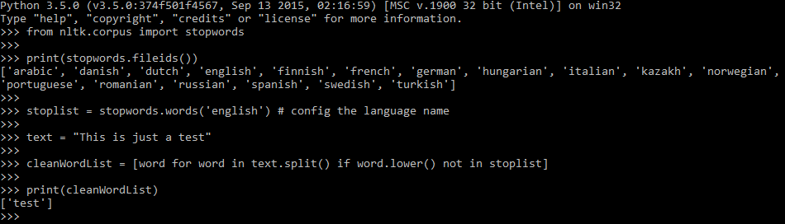
Stop word removal example

Slide 24
Rare word removal

Slide 25
Rare word removal
This is very intuitive, as some of the words that are very unique in nature like names, brands, product names, and some of the noise characters, such as html tags, need to be removed for different NLP tasks.
For example, it would be really bad to use names as a predictor for a text classification problem, even if they come out as a significant predictor. We will talk about this further in subsequent chapters.
We definitely don't want all these noisy tokens to be present. We also use length of the words as a criteria for removing words with very a short length or a very long length.
Notes:
Αυτό είναι πολύ ευκολονοητο, καθώς ορισμένες από τις λέξεις που είναι πολύ μοναδικές στη φύση όπως ονόματα, μάρκες, ονόματα προϊόντων και ορισμένοι χαρακτήρες θορύβου,
όπως html tags, πρέπει να καταργηθούν για διαφορετικές εργασίες NLP.
use … predicator = χρησιμοποιήστε ονόματα ως δείκτη πρόβλεψης για ένα πρόβλημα κατάταξης κειμένου, ακόμη και αν προκύψουν ότι είναι ενας σημαντικός δείκτης πρόβλεψης.
subsequent = μεταγενέστερο

Slide 26
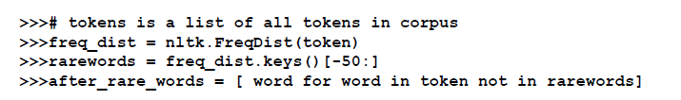
Rare word removal example
We are using the FreqDist() function to get the distribution of the terms in the corpus, selecting the rarest one into a list, and then filtering our original corpus. We can also do it for individual documents, as well.
Notes:
We can also do it for individual documents, as well =
Μπορούμε επίσης να το κάνουμε για μεμονωμένα έγγραφα

Slide 27
Spell correction

Slide 28
Spell correction
It is not a necessary to use a spellchecker for all NLP applications, but some use cases require you to use a basic spellcheck. We can create a very basic spellchecker by just using a dictionary lookup.
There are some enhanced string algorithms that have been developed for fuzzy string matching. One of the most commonly used is edit-distance. NLTK also provides you with a variety of metrics module that has edit_distance.
Notes:
Υπάρχουν μερικοί βελτιμενοι αλγόριθμοι συμβολοσειρών που έχουν αναπτυχθεί για αντιστοίχιση ασαφών συμβολοσειρών

Slide 29
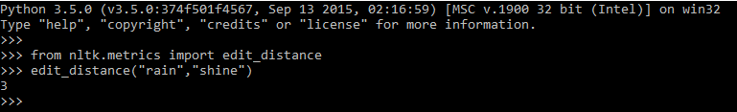
Spell correction example
Calculate the Levenshtein edit-distance between two strings. The edit distance is the number of characters that need to be substituted, inserted, or deleted, to transform s1 into s2.
For example, transforming “rain” to “shine” requires three steps, consisting of two substitutions and one insertion: “rain” -> “sain” -> “shin” -> “shine”. These operations could have been done in other orders, but at least three steps are needed.
Notes:
Substituted = αντικατασταθεί

Slide 30
Questions
?

